Slide 1
Project presentation
Topic: Fractional Fourier neural operator on partial differential equations
Student: Suwei Yang
Advisor: Shandian Zhe

Slide 2
Improvement list
P4 part by part to show
P.6 v to t
P6 add fno wno title
P11 express high freq and non stationary
Explain dataset number, at result
Numerical generation
Burger’s v=0 valid or not it is valid! It is called inviscid burger
Wave’s v valid or not
Fixed model architecture

Slide 3
Outline
Problem definition
Motivation
What did I do?
Result
Conclusion

Slide 4
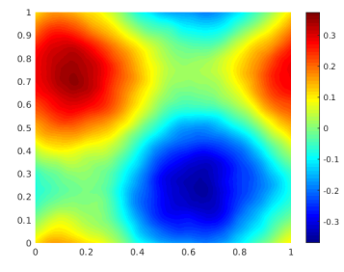
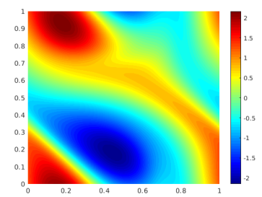
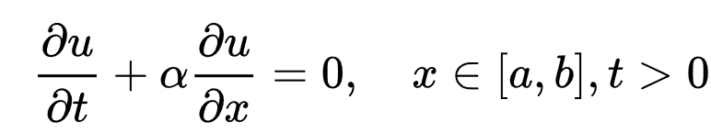




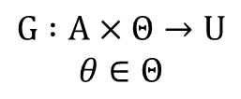

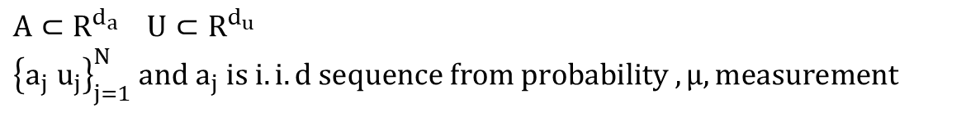


Problem definition
After t
$$a= u\left(x,0\right)$$
$$u=u(x,t)$$
Nonlinear map
$$G^{†} : A→U$$
Goal
$$G_{θ }: A→U$$
Observation
$A⊂R^{d_{a}} U⊂R^{d_{u}}$
${\left\{a_{j} u_{j}\right\}}_{j=1}^{N} and a_{j} is i.i.d sequence from probability ,μ, measurement$
Method
$$G :A×Θ→U$$
$$θ∈Θ$$
$$\min_{θ∈Θ}{E_{a\sim μ}[cost(G_{θ }\left(a,θ\right),G^{†}(a))]}$$
Ref: Fourier Neural Operator for Parametric Partial Differential Equations

Slide 5

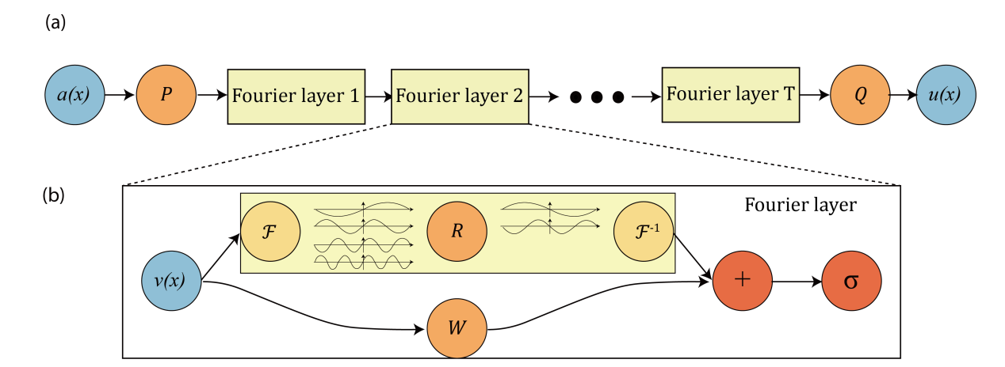
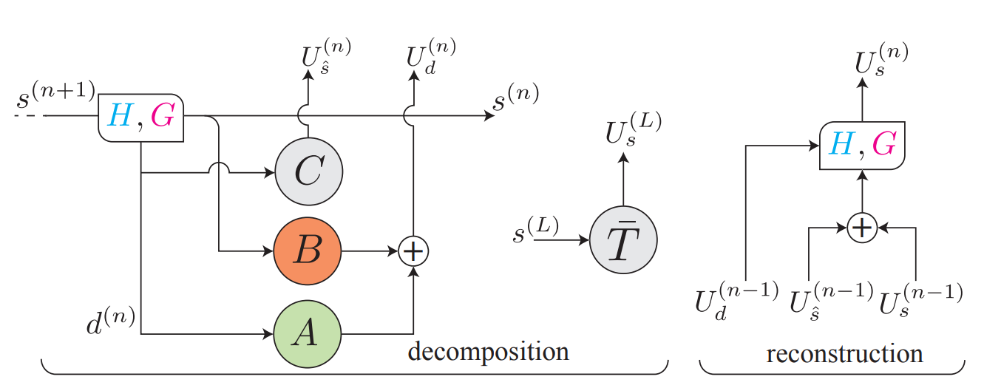



Problem definition
People have done…
Comparison:
FNO:
Fast
No time information
WNO:
Slow
With time information
Fourier transform(FNO)
Wavelet transform (WNO)
frequency
frequency
Abandoned
Important
Important
t
t
amp
amp
Fractional Fourier transform
(FRFT)
Ref: Fourier Neural Operator for Parametric Partial Differential Equations
Multiwavelet-based Operator Learning for Differential Equations

Slide 6
Outline
Problem definition
Motivation
What did I do?
Result
Conclusion

Slide 7



Motivation
frequency
frequency
Abandoned
Important
Important
t
t
amp
amp
FNO
WNO
frequency
FRFT
Blind area +
Lose high-frequency information
frequency
noise
Signal
frequency
noise
Signal
Time complexity:
O(L*N)+
Wavelet options
Time complexity:
O(NlogN)
t
Important
t
t
amp
Blind area
amp
amp
Ref: Optimal Filtering in Fractional Fourier Domains
Notes:
Wavelet transform complexity: O(L*N) where L are layers for filters and N is the signal length
Depend on how fine the information we want we need that much layers

Slide 8
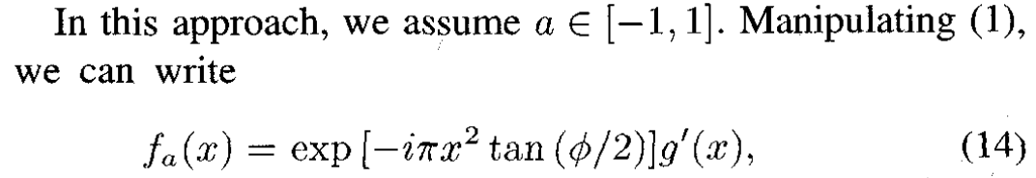

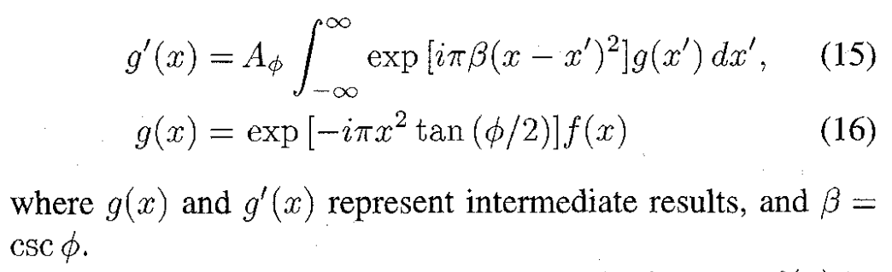
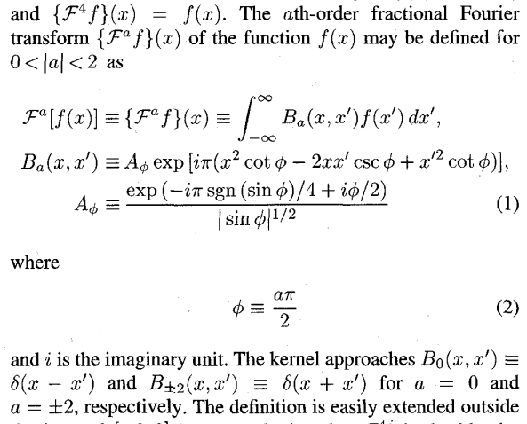

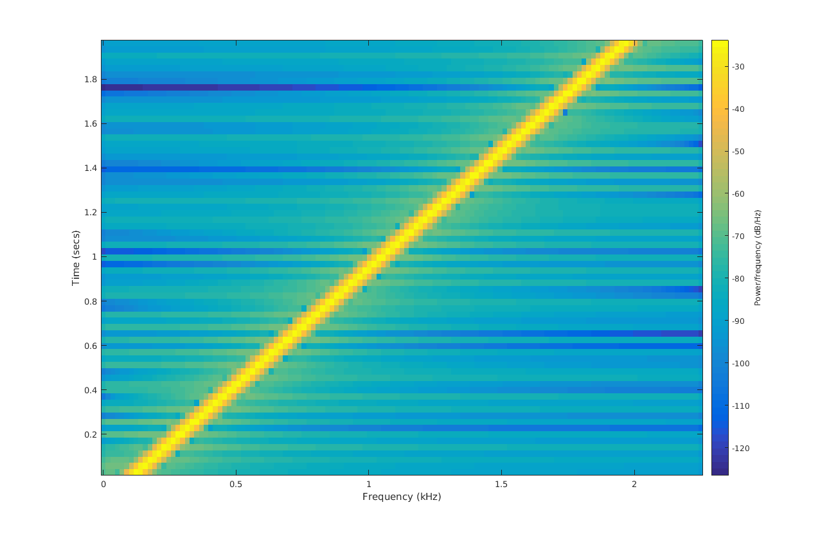
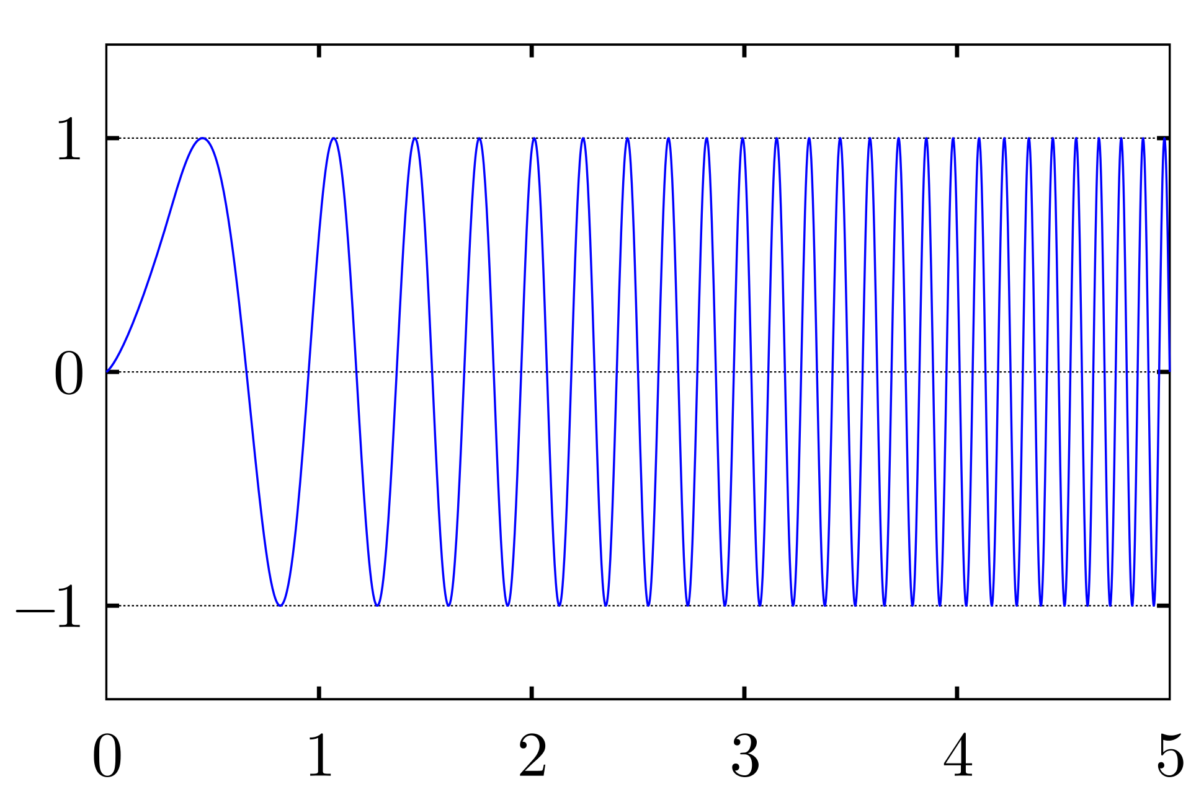
Motivation
frequency
noise
Signal
v
amp
$$Signal_{α}=Chirp ∗Conv(Chirp, Chirp∗signal_{t})$$
Time Complexity: NlogN
frequency
Chirp signal
Ref: Optimal Filtering in Fractional Fourier Domains
Digital Computation of the Fractional Fourier Transform
t
amp

Slide 9
Outline
Problem definition
Motivation
What did I do?
Result
Conclusion

Slide 10

What did I do?
frequency
Signal
noise
v
amp
Find cases
High-frequency + Non-stationary dataset
Prove it works
Applying FRFT to it

Slide 11
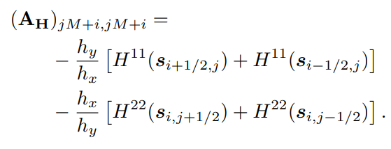
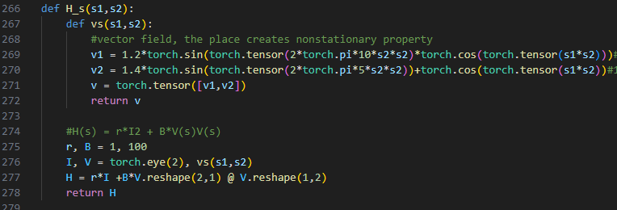
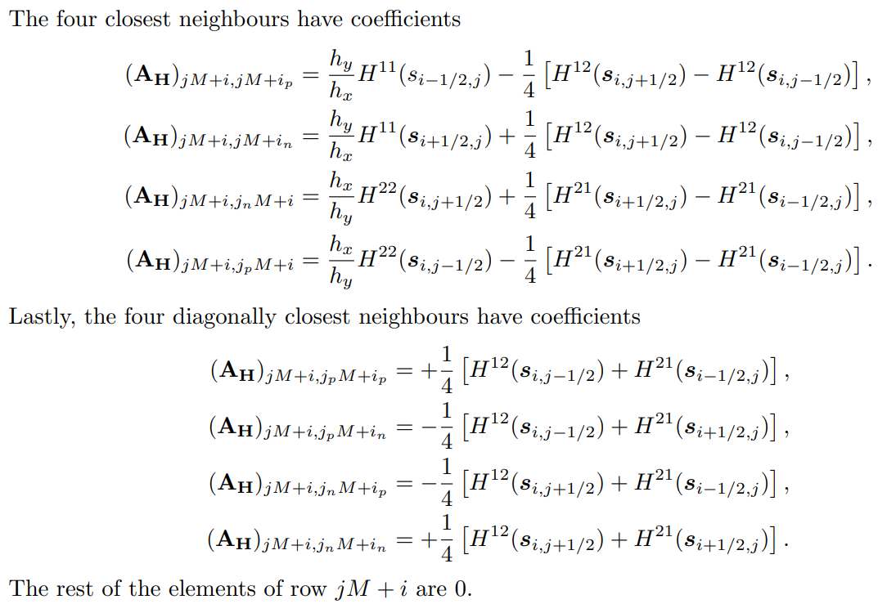


What did I do?
frequency
Signal
noise
v
amp
Find cases
High-frequency + Non-stationary dataset
Prove it works
Applying FRFT to it
$$u\left(s\right)∝\exp\left(−\frac{1}{2}s^{T}Qs\right)$$
$$Q=A^{T}D_{v}A$$
$$A=D_{v}D_{k^{2}}−A_{H}$$
$$A_{H}=R^{MN−1×MN−1}$$
When H(s) is a constant,
u(s) is a stationary dataset.
When H(s) has vector fields,
u(s) is a non-stationary dataset.
$$\left(k^{2}−∇H(s)∇\right)u\left(s\right)=W\left(s\right)$$
$$k>0, s∈D=\left[A_{1},B_{1}\right]×\left[A_{2},B_{2}\right] ⊂R^{2},$$
$$∇ =[\frac{∂ }{∂s_{1}},\frac{∂ }{∂s_{2}}]$$
$$H\left(s\right)=function with vector field,$$
$$u\left(s\right)=nonstationary dataset,$$
$$W\left(s\right)=standard gaussian white noise$$
$$H\left(s\right)=γI_{2}+Βv\left(s\right)v{\left(s\right)}^{T},γ,Β>0$$
Ref: Exploring a New Class of Non-stationary Spatial Gaussian Random Fields with Varying Local Anisotropy

Slide 12
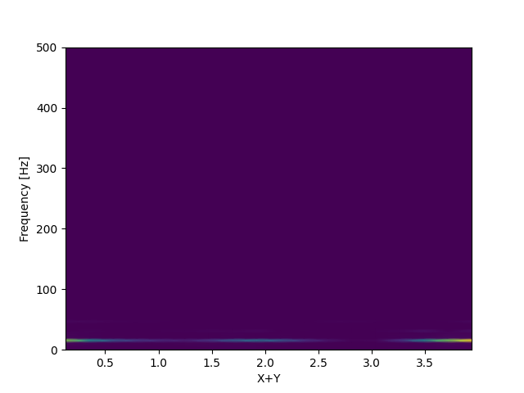
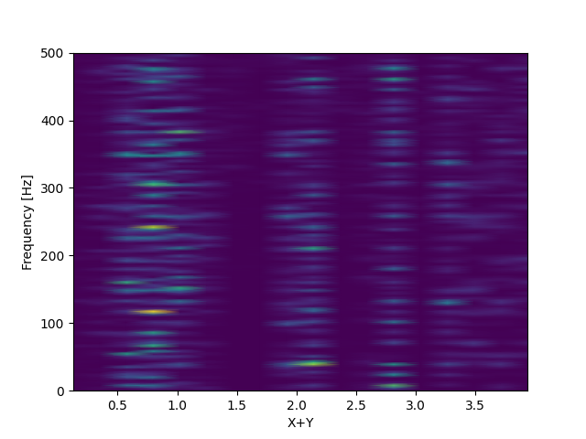
What did I do?
frequency
Signal
noise
v
amp
Low frequency + stationery
High frequency + non-stationery
Find cases
High-frequency + Non-stationary dataset
Prove it works
Applying FRFT to it
$$u\left(s\right)∝\exp\left(−\frac{1}{2}s^{T}Qs\right)$$
$$Q=A^{T}D_{v}A$$
$$A=D_{v}D_{k^{2}}−A_{H}$$
$$A_{H}=R^{MN−1×MN−1}$$
When H(s) is a constant,
u(s) is a stationary dataset.
When H(s) has vector fields,
u(s) is a non-stationary dataset.
$$\left(k^{2}−∇H(s)∇\right)u\left(s\right)=W\left(s\right)$$
$$k>0, s∈D=\left[A_{1},B_{1}\right]×\left[A_{2},B_{2}\right] ⊂R^{2},$$
$$∇ =[\frac{∂ }{∂s_{1}},\frac{∂ }{∂s_{2}}]$$
$$H\left(s\right)=function with vector field,$$
$$u\left(s\right)=nonstationary dataset,$$
$$W\left(s\right)=standard gaussian white noise$$
$$H\left(s\right)=γI_{2}+Βv\left(s\right)v{\left(s\right)}^{T},γ,Β>0$$
Gets:
High frequency when s2 goes up
Non-stationary with s2
Ref: Exploring a New Class of Non-stationary Spatial Gaussian Random Fields with Varying Local Anisotropy

Slide 13



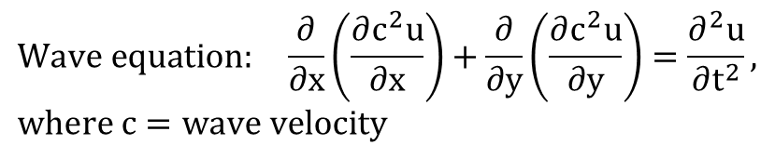
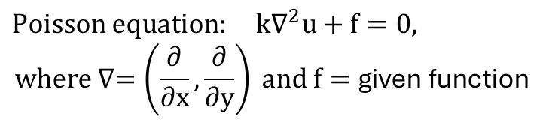
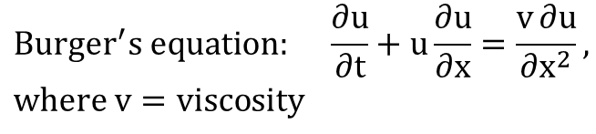
What did I do?
frequency
Signal
noise
v
amp
$$Burger^{′}s equation: \frac{∂u}{∂t}+u\frac{∂u}{∂x}=\frac{v∂u}{∂x^{2}}, where v=viscosity$$
Find cases
High-frequency + Non-stationary dataset
Prove it works
Applying FRFT to it
Goal: u(x,0)-> u(x,t)
$Poisson equation: k∇^{2}u+f=0,$
$$where ∇=\left(\frac{∂}{∂x},\frac{∂}{∂y}\right) and f=\text{given} \text{function}$$
$$a= u\left(x,0\right)$$
$$u=u(x,t)$$
Goal: f(x,y)-> u(x,y)
$$Wave equation: \frac{∂}{∂x}\left(\frac{∂c^{2}u}{∂x}\right)+\frac{∂}{∂y}\left(\frac{∂c^{2}u}{∂y}\right)=\frac{∂^{2}u}{∂t^{2}}, where c=wave velocity$$
Add it as the initial condition
$$u\left(s,0\right)∝\exp\left(−\frac{1}{2}s^{T}Qs\right)$$
Goal: u(x,y,0)-> u(x,y,t)

Slide 14
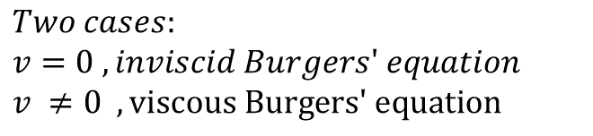
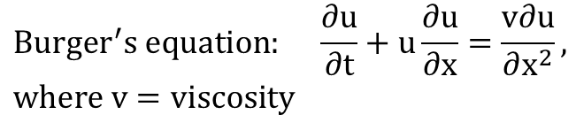
What did I do?
frequency
Signal
noise
v
amp
$$Burger^{′}s equation: \frac{∂u}{∂t}+u\frac{∂u}{∂x}=\frac{v∂u}{∂x^{2}}, where v=viscosity$$
Find cases
High-frequency + Non-stationary dataset
Prove it works
Applying FRFT to it
Goal: u(x,0)-> u(x,t)
$Two cases:$
$v=0 ,inviscid Burgers′ equation$
$v ≠0 , \text{viscous} \text{Burgers}\text{′ }\text{equation}$
$$a= u\left(x,0\right)$$
$$u=u(x,t)$$
Add it as the initial condition
$$u\left(s,0\right)∝\exp\left(−\frac{1}{2}s^{T}Qs\right)$$

Slide 15

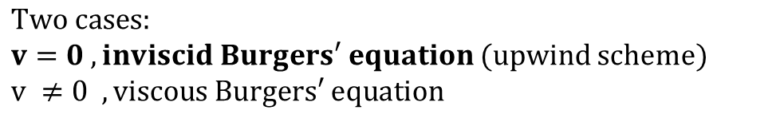
What did I do?
frequency
Signal
noise
v
amp
$$Burger^{′}s equation: \frac{∂u}{∂t}+u\frac{∂u}{∂x}=\frac{v∂u}{∂x^{2}}, where v=viscosity$$
Find cases
High-frequency + Non-stationary dataset
Prove it works
Applying FRFT to it
Goal: u(x,0)-> u(x,t)
$Two cases:$
$v=0 ,inviscid Burgers′ equation$ (upwind scheme)
$v ≠0 , \text{viscous} \text{Burgers}\text{′ }\text{equation}$
$\frac{∂u}{∂t}+u\frac{∂u}{∂x}=0, introduce f\left(u\right)=\frac{u^{2}}{2}$
$⇒\frac{∂u}{∂t}+\frac{∂f}{∂u}\frac{∂u}{∂x}=0$
$⇒\frac{∂u}{∂t}+\frac{∂f}{∂x}=0$
$⇒\frac{u_{j}^{n+1}{−u}_{j}^{n}}{Δt}=\frac{{f(u}_{j}^{n}){−f(u}_{j+1}^{n})}{Δx}$ ,
Where n: time point, and j: x points
$$a= u\left(x,0\right)$$
$$u=u(x,t)$$
Add it as the initial condition
$$u\left(s,0\right)∝\exp\left(−\frac{1}{2}s^{T}Qs\right)$$
Ref: https://github.com/gilbertfrancois/partial-differential-equations/blob/master/notebook/1D%20Burgers%27%20equation%2C%20finite%20volume%2C%20upwind%20scheme.ipynb

Slide 16
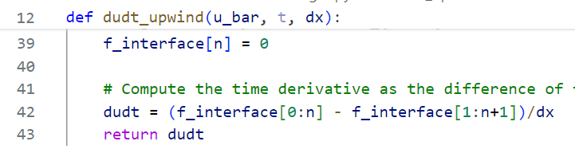
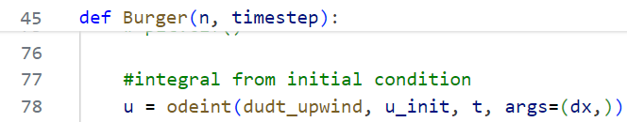
What did I do?
frequency
Signal
noise
v
amp
$$Burger^{′}s equation: \frac{∂u}{∂t}+u\frac{∂u}{∂x}=\frac{v∂u}{∂x^{2}}, where v=viscosity$$
Find cases
High-frequency + Non-stationary dataset
Prove it works
Applying FRFT to it
Goal: u(x,0)-> u(x,t)
$Two cases:$
$v=0 ,inviscid Burgers′ equation$ (upwind scheme)
$v ≠0 , \text{viscous} \text{Burgers}\text{′ }\text{equation}$
$\frac{∂u}{∂t}+u\frac{∂u}{∂x}=0, introduce f\left(u\right)=\frac{u^{2}}{2}$
$⇒\frac{∂u}{∂t}+\frac{∂f}{∂u}\frac{∂u}{∂x}=0$
$⇒\frac{∂u}{∂t}+\frac{∂f}{∂x}=0$
$⇒\frac{u_{j}^{n+1}{−u}_{j}^{n}}{Δt}=\frac{{f(u}_{j}^{n}){−f(u}_{j+1}^{n})}{Δx}$ ,
Where n: time point, and j: x points
$$a= u\left(x,0\right)$$
$$u=u(x,t)$$
Add it as the initial condition
$$u\left(s,0\right)∝\exp\left(−\frac{1}{2}s^{T}Qs\right)$$
Ref: https://github.com/gilbertfrancois/partial-differential-equations/blob/master/notebook/1D%20Burgers%27%20equation%2C%20finite%20volume%2C%20upwind%20scheme.ipynb

Slide 17
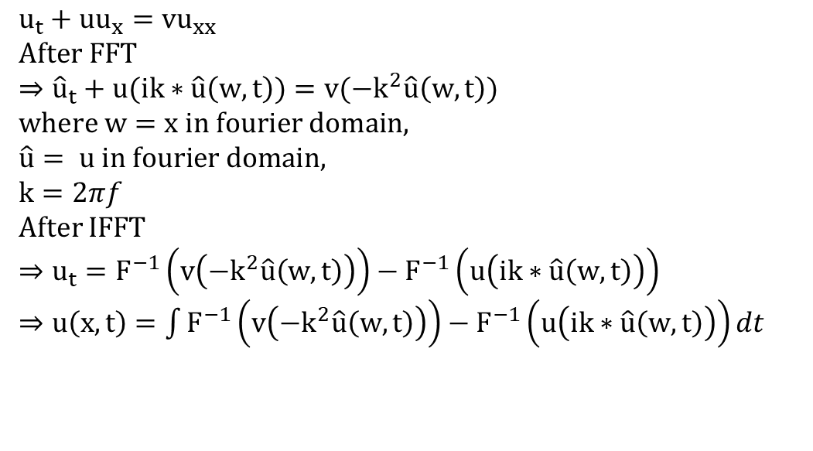
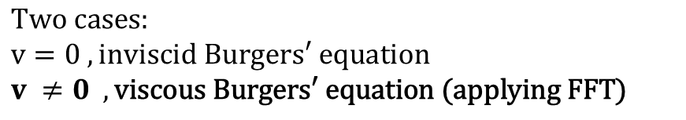
What did I do?
frequency
Signal
noise
v
amp
$$Burger^{′}s equation: \frac{∂u}{∂t}+u\frac{∂u}{∂x}=\frac{v∂u}{∂x^{2}}, where v=viscosity$$
Find cases
High-frequency + Non-stationary dataset
Prove it works
Applying FRFT to it
Goal: u(x,0)-> u(x,t)
$Two cases:$
$v=0 ,inviscid Burgers′ equation$
$v ≠0 , \text{viscous} \text{Burgers}\text{′ }\text{equation}\text{ (}\text{applying} \text{FFT}\text{)}$
$u_{t}+uu_{x}=vu_{xx}$
$After FFT$
$⇒{\hat{u}}_{t}+u(ik∗\hat{u}\left(w,t\right))=v({−k}^{2}\hat{u}\left(w,t\right))$
$where w=x in fourier domain,$
$\hat{u}= u in fourier domain,$
$k=2πf$
After IFFT
$⇒u_{t}=F^{−1}\left(v\left({−k}^{2}\hat{u}\left(w,t\right)\right)\right)−F^{−1}\left(u\left(ik∗\hat{u}\left(w,t\right)\right)\right)$
$⇒u\left(x,t\right)=\int{F^{−1}\left(v\left({−k}^{2}\hat{u}\left(w,t\right)\right)\right)−F^{−1}\left(u\left(ik∗\hat{u}\left(w,t\right)\right)\right)dt}$
$$a= u\left(x,0\right)$$
$$u=u(x,t)$$
Add it as the initial condition
$$u\left(s,0\right)∝\exp\left(−\frac{1}{2}s^{T}Qs\right)$$
Ref: https://github.com/sachabinder/Burgers_equation_simulation/blob/main/Burgers_solver_SP.py

Slide 18
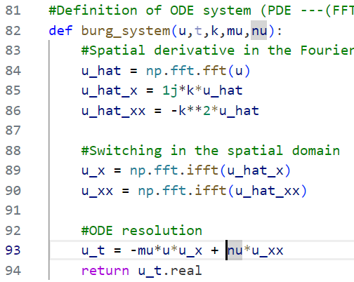
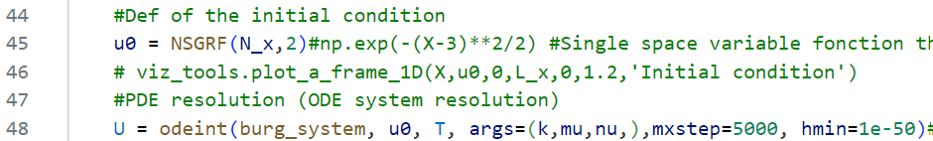
What did I do?
frequency
Signal
noise
v
amp
$$Burger^{′}s equation: \frac{∂u}{∂t}+u\frac{∂u}{∂x}=\frac{v∂u}{∂x^{2}}, where v=viscosity$$
Find cases
High-frequency + Non-stationary dataset
Prove it works
Applying FRFT to it
Goal: u(x,0)-> u(x,t)
$Two cases:$
$v=0 ,inviscid Burgers′ equation$
$v ≠0 , \text{viscous} \text{Burgers}\text{′ }\text{equation}\text{ (}\text{applying} \text{FFT}\text{)}$
$u_{t}+uu_{x}=vu_{xx}$
$After FFT$
$⇒{\hat{u}}_{t}+u(ik∗\hat{u}\left(w,t\right))=v({−k}^{2}\hat{u}\left(w,t\right))$
$where w=x in fourier domain,$
$\hat{u}= u in fourier domain,$
$k=2πf$
After IFFT
$⇒u_{t}=F^{−1}\left(v\left({−k}^{2}\hat{u}\left(w,t\right)\right)\right)−F^{−1}\left(u\left(ik∗\hat{u}\left(w,t\right)\right)\right)$
$⇒u\left(x,t\right)=\int{F^{−1}\left(v\left({−k}^{2}\hat{u}\left(w,t\right)\right)\right)−F^{−1}\left(u\left(ik∗\hat{u}\left(w,t\right)\right)\right)dt}$
$$a= u\left(x,0\right)$$
$$u=u(x,t)$$
Add it as the initial condition
$$u\left(s,0\right)∝\exp\left(−\frac{1}{2}s^{T}Qs\right)$$
Ref: https://github.com/sachabinder/Burgers_equation_simulation/blob/main/Burgers_solver_SP.py

Slide 19
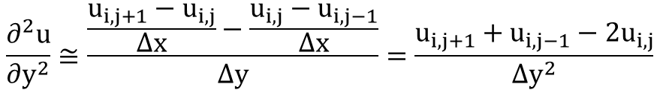
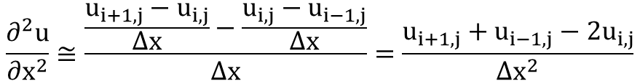
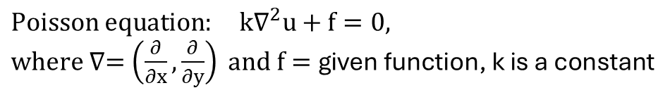
What did I do?
frequency
Signal
noise
v
amp
$Poisson equation: k∇^{2}u+f=0,$
$where ∇=\left(\frac{∂}{∂x},\frac{∂}{∂y}\right) and f=\text{given} \text{function}\text{, }\text{k} \text{is} \text{a} \text{constant}$
Find cases
High-frequency + Non-stationary dataset
Prove it works
Applying FRFT to it
Goal: f(x,y)-> u(x,y)
Applying finite difference method:
$$\frac{∂^{2}u}{∂x^{2}}≅\frac{\frac{u_{i+1,j}−u_{i,j}}{Δx}−\frac{u_{i,j}−u_{i−1,j}}{Δx}}{Δx}=\frac{u_{i+1,j}+u_{i−1,j}−2u_{i,j}}{Δx^{2}}$$
$$a= u\left(x,0\right)$$
$$\frac{∂^{2}u}{∂y^{2}}≅\frac{\frac{u_{i,j+1}−u_{i,j}}{Δx}−\frac{u_{i,j}−u_{i,j−1}}{Δx}}{Δy}=\frac{u_{i,j+1}+u_{i,j−1}−2u_{i,j}}{Δy^{2}}$$
$$u=u(x,t)$$
Add it as the initial condition
Au = -f, where
A= derivative matrix, u=solution, -f = given function
$$u\left(s,0\right)∝\exp\left(−\frac{1}{2}s^{T}Qs\right)$$
Ref: https://github.com/gilbertfrancois/partial-differential-equations/blob/master/notebook/2D%20Poisson%20equation%2C%20finite%20difference.ipynb

Slide 20
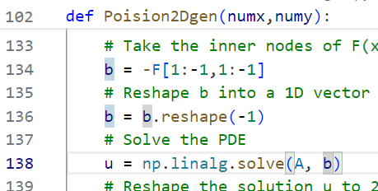
What did I do?
frequency
Signal
noise
v
amp
$Poisson equation: k∇^{2}u+f=0,$
$where ∇=\left(\frac{∂}{∂x},\frac{∂}{∂y}\right) and f=\text{given} \text{function}\text{, }\text{k} \text{is} \text{a} \text{constant}$
Find cases
High-frequency + Non-stationary dataset
Prove it works
Applying FRFT to it
Goal: f(x,y)-> u(x,y)
Applying finite difference method:
$$\frac{∂^{2}u}{∂x^{2}}≅\frac{\frac{u_{i+1,j}−u_{i,j}}{Δx}−\frac{u_{i,j}−u_{i−1,j}}{Δx}}{Δx}=\frac{u_{i+1,j}+u_{i−1,j}−2u_{i,j}}{Δx^{2}}$$
$$a= u\left(x,0\right)$$
$$\frac{∂^{2}u}{∂y^{2}}≅\frac{\frac{u_{i,j+1}−u_{i,j}}{Δx}−\frac{u_{i,j}−u_{i,j−1}}{Δx}}{Δy}=\frac{u_{i,j+1}+u_{i,j−1}−2u_{i,j}}{Δy^{2}}$$
$$u=u(x,t)$$
Add it as the initial condition
Au = -f, where
A= derivative matrix, u=solution, -f = given function
$$u\left(s,0\right)∝\exp\left(−\frac{1}{2}s^{T}Qs\right)$$
Ref: https://github.com/gilbertfrancois/partial-differential-equations/blob/master/notebook/2D%20Poisson%20equation%2C%20finite%20difference.ipynb

Slide 21

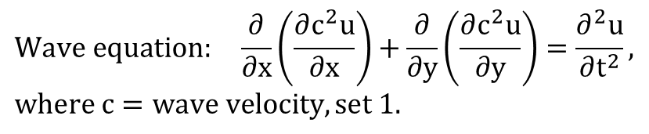
What did I do?
frequency
Signal
noise
v
amp
$$Wave equation: \frac{∂}{∂x}\left(\frac{∂c^{2}u}{∂x}\right)+\frac{∂}{∂y}\left(\frac{∂c^{2}u}{∂y}\right)=\frac{∂^{2}u}{∂t^{2}}, where c=wave velocity, set 1.$$
Find cases
High-frequency + Non-stationary dataset
Prove it works
Applying FRFT to it
Goal: u(x,y,0)-> u(x,y,t)
Applying finite difference method to solve it
$\frac{∂^{2}u}{∂t^{2}}=\frac{∂^{2}u}{∂x^{2}}+\frac{∂^{2}u}{∂y^{2}}$
$⇒\frac{u_{i,j}^{t+1}+u_{i,j}^{t−1}−2u_{i,j}^{t}}{Δt^{2}}=\frac{u_{i+1,j}^{t}+u_{i−1,j}^{t}−2u_{i,j}^{t}}{Δx^{2}}$+ $\frac{u_{i,j+1}^{t}+u_{i,j−1}^{t}−2u_{i,j}^{t}}{Δy^{2}}$
$⇒u_{i,j}^{t+1}={2u}_{i,j}^{t}−u_{i,j}^{t−1}+\frac{Δt^{2}}{Δx^{2}}\left(u_{i+1,j}^{t}+u_{i−1,j}^{t}−2u_{i,j}^{t}\right)+$
$\frac{Δt^{2}}{Δy^{2}}\left(u_{i,j+1}^{t}+u_{i,j−1}^{t}−2u_{i,j}^{t}\right)$
Adding initial velocity(v) when t=1(some applications might need)
$⇒u_{i,j}^{t+1}={2u}_{i,j}^{t}−u_{i,j}^{t−1}−2Δtv_{i,j}+\frac{Δt^{2}}{Δx^{2}}\left(u_{i+1,j}^{t}+u_{i−1,j}^{t}−2u_{i,j}^{t}\right)+$
$\frac{Δt^{2}}{Δy^{2}}\left(u_{i,j+1}^{t}+u_{i,j−1}^{t}−2u_{i,j}^{t}\right)$
$$a= u\left(x,0\right)$$
$$u=u(x,t)$$
Add it as the initial condition
$$u\left(s,0\right)∝\exp\left(−\frac{1}{2}s^{T}Qs\right)$$
Ref: https://github.com/sachabinder/wave_equation_simulations/blob/main/2D_WAVE-EQ_variable-velocity.py

Slide 22
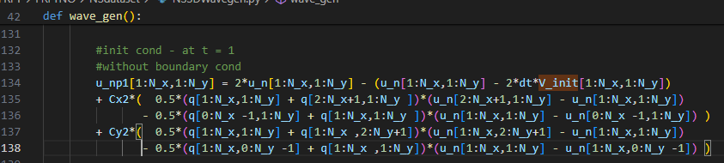


What did I do?
frequency
Signal
noise
v
amp
$$Wave equation: \frac{∂}{∂x}\left(\frac{∂c^{2}u}{∂x}\right)+\frac{∂}{∂y}\left(\frac{∂c^{2}u}{∂y}\right)=\frac{∂^{2}u}{∂t^{2}}, where c=wave velocity, set 1.$$
Find cases
High-frequency + Non-stationary dataset
Prove it works
Applying FRFT to it
Goal: u(x,y,0)-> u(x,y,t)
Applying finite difference method to solve it
$\frac{∂^{2}u}{∂t^{2}}=\frac{∂^{2}u}{∂x^{2}}+\frac{∂^{2}u}{∂y^{2}}$
$⇒\frac{u_{i,j}^{t+1}+u_{i,j}^{t−1}−2u_{i,j}^{t}}{Δt^{2}}=\frac{u_{i+1,j}^{t}+u_{i−1,j}^{t}−2u_{i,j}^{t}}{Δx^{2}}$+ $\frac{u_{i,j+1}^{t}+u_{i,j−1}^{t}−2u_{i,j}^{t}}{Δy^{2}}$
$⇒u_{i,j}^{t+1}={2u}_{i,j}^{t}−u_{i,j}^{t−1}+\frac{Δt^{2}}{Δx^{2}}\left(u_{i+1,j}^{t}+u_{i−1,j}^{t}−2u_{i,j}^{t}\right)+$
$\frac{Δt^{2}}{Δy^{2}}\left(u_{i,j+1}^{t}+u_{i,j−1}^{t}−2u_{i,j}^{t}\right)$
Adding initial velocity(v) when t=1(some applications might need)
$⇒u_{i,j}^{t+1}={2u}_{i,j}^{t}−u_{i,j}^{t−1}−2Δtv_{i,j}+\frac{Δt^{2}}{Δx^{2}}\left(u_{i+1,j}^{t}+u_{i−1,j}^{t}−2u_{i,j}^{t}\right)+$
$\frac{Δt^{2}}{Δy^{2}}\left(u_{i,j+1}^{t}+u_{i,j−1}^{t}−2u_{i,j}^{t}\right)$
$$a= u\left(x,0\right)$$
$$u=u(x,t)$$
Add it as the initial condition
$$u\left(s,0\right)∝\exp\left(−\frac{1}{2}s^{T}Qs\right)$$
Ref: https://github.com/sachabinder/wave_equation_simulations/blob/main/2D_WAVE-EQ_variable-velocity.py
Notes:
q[I,j] is wave velocity, which is 1 everywhere
V_init is wave initial velocity, only add in the beginning and is removed after t>1

Slide 23





What did I do?
frequency
Signal
noise
v
amp
Find cases
High-frequency + Non-stationary dataset
Prove it works
Applying FRFT to it
a(x)
P
FRFT layer1
…
Q
u(x)
FRFT layer 4
Based on
FNO architecture
$$F^{α}$$
All information
$$R(θ)$$
All information
$$F^{−α}$$
FRFT layer
+
$$σ$$
$$W$$
Ref: Fourier Neural Operator for Parametric Partial Differential Equations

Slide 24
Outline
Problem definition
Motivation
What did I do?
Result
Conclusion

Slide 25
Result - burger’s equation
Test l2 error | V=0 | V=0.001
Train 1& Test 1 | 0.069647 | 0.032559
Train 2 & Test 2 | 0.064908 | 0.031946
Train 3 & Test 3 | 0.067103 | 0.0264
Train 4 & Test 4 | 0.055544 | 0.026487
FRFTNO avg. | 0.064300 | 0.029348
A: Fourier layer, B: FRFT layer
Architecture: AABB(v=0), ABBB(v=0.001)
Dataset size 200
Test sequence:
Train1:dataset[:30], Test1: dataset[-100:]
Train2 dataset[30:60], Test2 dataset[-100:]
Train3 dataset[60:90], Test3 dataset[-100:]
Train4 dataset[-30:], Test 4 dataset[:100]
Test l2 error | V=0 | V=0.001
Train 1& Test 1 | 0.083705 | 0.045617
Train 2 & Test 2 | 0.089063 | 0.045515
Train 3 & Test 3 | 0.082765 | 0.048091
Train 4 & Test 4 | 0.09321 | 0.04524
FNO all modes avg. | 0.087186 | 0.046116

Slide 26
Result - poisson’s equation
Test l2 error
Train 1& Test 1 | 0.371117
Train 2 & Test 2 | 0.354186
Train 3 & Test 3 | 0.334832
Train 4 & Test 4 | 0.355024
FRFTNO avg. | 0.353790
A: Fourier layer, B: FRFT layer
Architecture: BAAA
Dataset size 200
Test sequence:
Train1:dataset[:30], Test1: dataset[-100:]
Train2 dataset[30:60], Test2 dataset[-100:]
Train3 dataset[60:90], Test3 dataset[-100:]
Train4 dataset[-30:], Test 4 dataset[:100]
Test l2 error
Train 1& Test 1 | 0.448968
Train 2 & Test 2 | 0.449978
Train 3 & Test 3 | 0.444467
Train 4 & Test 4 | 0.445845
FNO all modes avg. | 0.447315

Slide 27
Result - wave’s equation
Test l2 error | V=0 | V=0.001
Train 1& Test 1 | 0.06064 | 0.062344
Train 2 & Test 2 | 0.060401 | 0.060734
Train 3 & Test 3 | 0.061143 | 0.060232
Train 4 & Test 4 | 0.059051 | 0.063212
FRFTNO avg | 0.06031 | 0.061631
A: Fourier layer, B: FRFT layer
Architecture: BAAB(V=0), BBAB(V=0.001)
Dataset size 200
Test sequence:
Train1:dataset[:30], Test1: dataset[-100:]
Train2 dataset[30:60], Test2 dataset[-100:]
Train3 dataset[60:90], Test3 dataset[-100:]
Train4 dataset[-30:], Test 4 dataset[:100]
Test l2 error | V=0 | V=0.001
Train 1& Test 1 | 0.07214 | 0.067753
Train 2 & Test 2 | 0.069251 | 0.07335
Train 3 & Test 3 | 0.073995 | 0.072818
Train 4 & Test 4 | 0.072781 | 0.070534
FNO all modes avg. | 0.072042 | 0.071114

Slide 28
Outline
Problem definition
Motivation
What did I do?
Result
Conclusion

Slide 29
Conclusion
High-frequency dataset
Non-stationary dataset
Fractional Fourier transform
Future work: Linear canonical transform??

Slide 30



Result – by manual
$$Burger^{′}s equation: \frac{∂u}{∂t}+u\frac{∂u}{∂x}=\frac{v∂u}{∂x^{2}}, where v=vecosity$$
$$Poisson equation: k∇^{2}u+f=0, where ∇=\left(\frac{∂}{∂x},\frac{∂}{∂y}\right) and f=\text{given} \text{function}$$
$$Wave equation: \frac{∂}{∂x}\left(\frac{∂c^{2}u}{∂x}\right)+\frac{∂}{∂y}\left(\frac{∂c^{2}u}{∂y}\right)=\frac{∂^{2}u}{∂t^{2}}, where c=wave velocity$$
Burger equation | Train error(v=0) | Test error(v=0) | Train error(v=0.001) | Test error(v=0.001)
FNO | 0.001452013 | 0.08370549 | 0.005017 | 0.045617
FRFTNO | 0.012690056 | 0.055142305 | 0.011902 | 0.035232
Poisson equation | Train | Test
FNO | 0.000364 | 0.448968
FRFTNO | 0.004806 | 0.352961
Wave equation v = initial speed | Train(v=0) | Test(v=0) | Train(v=0.001) | Test(v=0.001)
FNO | 0.050162 | 0.07214 | 0.048058 | 0.067753
FRFTNO | 0.050384 | 0.066653 | 0.046522 | 0.065375
At least, It works!

Slide 31
Burger equation
V: viscosity | V = 0 |  | V=0.001
500 epochs train N:30 test N:100 | Train | Test | Train | Test
FNO all mode 1 layer | 0.013424099 | 0.050683396 | 0.010348 | 0.035222
FNO all mode 2 layers | 0.002530336 | 0.075994416 | 0.005837 | 0.042177
FNO all mode 3 layers | 0.001308373 | 0.080793696 | 0.004668 | 0.043666
FNO all mode 4 layers | 0.001452013 | 0.08370549 | 0.005017 | 0.045617
FRFT 2 layers | 0.013170323 | 0.058556114 | 0.011052 | 0.036548
FRFT 3 layers | 0.013010737 | 0.055940504 | 0.011958 | 0.037162
FRFT 4 layers | 0.012690056 | 0.055142305 | 0.011902 | 0.035232

Slide 32
Poisson equation
 | Train | Test
FNO all mode 1 layer | 0.039793 | 0.853731
FNO all mode 2 layers | 0.00142 | 0.486432
FNO all mode 3 layers | 0.000299 | 0.459118
FNO all mode 4 layers | 0.000364 | 0.448968
FRFT 1 layers | 0.002698 | 0.717565
FRFT 2 layers | 0.001437 | 0.419202
FRFT 3 layers | 0.001727 | 0.379013
FRFT 4 layers | 0.004806 | 0.352961

Slide 33
Wave equation
V: initial speed | V = 0 |  | V=0.001
500 epochs train N:30 test N:100 | Train | Test | Train | Test
FNO all mode 1 layer | 0.04739 | 0.074811 | 0.046195 | 0.072238
FNO all mode 2 layers | 0.04586 | 0.080324 | 0.042334 | 0.078217
FNO all mode 3 layers | 0.046018 | 0.076723 | 0.044265 | 0.073412
FNO all mode 4 layers | 0.050162 | 0.07214 | 0.048058 | 0.067753
FRFT 2 layers | 0.039215 | 0.065856 | 0.042377 | 0.067792
FRFT 3 layers | 0.043247 | 0.062376 | 0.039679 | 0.061649
FRFT 4 layers | 0.050384 | 0.066653 | 0.046522 | 0.065375

